Slide 1
Operating System Basics

Slide 2
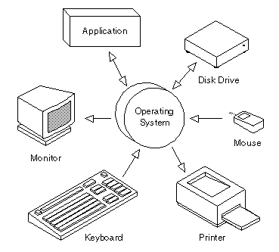
What is Operating System
The OS is one kind of system software that controls the system' s hardware and interacts with the user and application software.

Slide 3
In short, the operating system is the computer' s master control program.
It provides us with the tools (commands) that enable us to interact with the PC.
When we issue a command, the OS translates it into code that the machine can use.

Slide 4
What does it do?
The operating system performs the following functions:
Displays the on-screen elements with which user interact—the user interface.
Loads programs (such as word processing and spreadsheet programs) into the computer’s memory so that we can use them.
Coordinates how programs work with the computer' s hardware and other software.
Manages the way information is stored on and retrieved from disks.

Slide 5
Types of Operating Systems
Operating system s can be organized into four major types:
real-time,
single-user/single-tasking,
single-user/multi-tasking, and
multi-user/multi-tasking.

Slide 6
Real-Time Operating Systems
A real -time operating system is a very fast, relatively small OS.
Real-time OSs are often also embedded OSs, when they are built into the circuitry of a device and are not loaded from a disk drive.
Example: eCos, VxWorks, RTLinux

Slide 7
Real-Time Operating Systems
A real-time operating system is needed to run real-time applications;
it may support multiple simultaneous tasks, or it may only support single-tasking.
A real -time application is an application that responds to certain inputs extremely quickly—thousandths or millionths of a second (milliseconds or microseconds, respectively).

Slide 8
Single-User/Single-Tasking Operating Systems
An operating system that allows a single user to perform just one task at a time is a single-user/single-tasking operating system.
Example: MS-DOS

Slide 9
Single-U ser/Multitasking Operating Systems
A single-user/multi tasking operating system is one that allows a single user to perform two or more functions at once.
It takes a special operating system to keep two or ore tasks running at once.
Example: Windows - 98, Android, Symbian, IOS.

Slide 10
Single-U ser/Multitasking Operating Systems
Advantage:
The multitasking features of these OSs have greatly increased the productivity of people in a large variety of jobs because they can accomplish more in a shorter period of time.
It is also helpful for many types of workers to be able to have two or more programs open, to share the data between the two programs, and to be able to instantly switch between the two programs.

Slide 11
Single-U ser/Multitasking Operating Systems
Disadvantage:
is the increased size and complexity it needs to support multitasking,
while keeping the related features users have come to expect, such as a graphical user interface, and the ability to share data between two or more open programs.

Slide 12
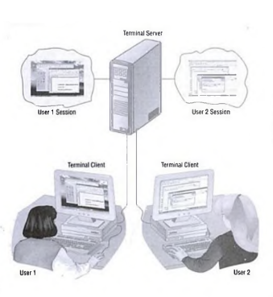
Multi-User/Multitasking Operating Systems
A multi-user/multitasking operating system is an operating system that allows multiple users to use programs that are simultaneously running on a single network server; called a terminal server.
Examples of multi-user OSs include UN IX, VMS, and mainframe operating sys­tems such as MVS.

Slide 13
Multi-User/Multitasking Operating Systems
Advantage:
can be managed by simply making changes to one server, rather than to many desktop computers.
allow the user to work with applications that require a more powerful computer than the user needs on the desktop to run the client.
Disadvantage:
if the network connection to the server is broken, the user cannot do any work in the applications on the server.

Slide 14
Providing a User Interface
When we work on a computer; we see and use a set of items on the screen. Taken together; these items are called the user interface.
The two most common types of user interfaces are
graphical and
command line

Slide 15
Graphical User Interfaces
Most current operating systems, including all versions of Windows, the Macintosh operating system, OS/2, and some versions of UNIX and Linux, provide a Graphical User Interface (GUI).
so called because you use a mouse (or some other pointing device) to work with graphical objects such as windows, menus, icons, buttons, and other tools.

Slide 16
Graphical User Interfaces
These graphical tools all represent different types of commands; the GUI enables you to issue commands to the computer by using visual objects instead of typing commands.
This is one of the key advantages of a graphical user interface; it frees you from memorizing and typing text commands.

Slide 17
Command-Line Interfaces
uses typewritten commands rather than graphical objects to execute tasks.
Some older operating systems (such as MS-DOS) and some current versions of UNIX and Linux feature a command-line interface
A command-line interface displays in character mode using only equal sized alphanumeric and other simple symbols.

Slide 18
Command-Line Interfaces
As much as people prefer to work in a GUI, a command-line interface gives you a quick way to enter commands,
even now Windows has an optional command-line interface, called the Command Prompt

Slide 19
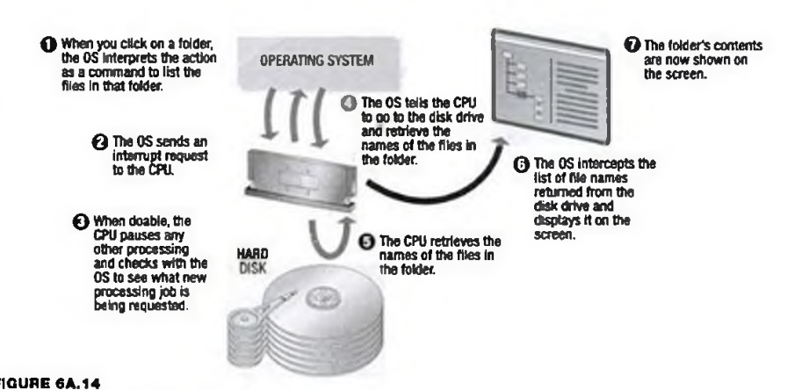

Slide 20
Enhancing an OS with Utility Software
Backup Utilities
Antivirus
Firewall
Intrusion Detection
Screen Savers

Slide 21
Virus
A virus is a parasitic program that can delete or scramble files or replicate itself until the host disk is full.
computer viruses can be transmitted in numerous ways
downloading files over the Internet or
reusing old diskettes that may be infected.

Slide 22
Antivirus
An antivirus utility can examine the contents of a disk or RAM for hidden viruses and files that may act as hosts for virus code.
Effective antivirus products not only detect and remove viruses; they also help you recover data that has been lost because of a virus.

